Slide 1

Sanjivani College of Engineering, Kopargaon-423603
Sanjivani Rural Education Society’s
(An Autonomous Institute Affiliated to Savitribai Phule Pune University, Pune)
NAAC ‘A’ Grade Accredited
Department of Information Technology
(UG program, NBA Accredited)
Software Engineering Modeling & Design
“Restaurant Management System ”
SEMD incharge Dr. S. N. Gunjal
Class : SY IT B

Slide 2

Group Members :
Roll No. | PRN | Name
123 | 0125UITF1123 | Charvande Shivani
124 | 0125UITF1124 | Dange Shraddha
125 | 0125UITM1125 | Gore Aditya
126 | 0125UITM1126 | Laware Kunal

Slide 3
Introduction :
A Hotel Management System is an essential tool in the hospitality industry and plays a crucial role in managing daily operations efficiently. However, many hotels still rely on traditional methods, which can limit productivity and lead to errors. Hotel staff often face challenges such as improper record management, difficulty in handling reservations, and lack of real-time updates.
With the advancement of technology, there is a need to modernize hotel operations by adopting digital solutions. An Online Hotel Management System is designed to provide a centralized platform where hotel staff can manage bookings, customer details, room availability, and billing processes efficiently. It also helps in maintaining records, improving customer service, and streamlining overall operations.
This system aims to reduce manual effort, improve accuracy and transparency, and support better decision-making, ultimately leading to enhanced efficiency and improved customer satisfaction.

Slide 4

Functional Requirements :
FR1: The system shall allow customers to register by providing personal details. FR2: The system shall allow registered users to log in using valid credentials. FR3: The system shall allow customers to search and view available rooms. FR4: The system shall allow customers to book rooms based on availability. FR5: The system shall allow customers to cancel or modify bookings. FR6: The system shall generate bills and manage payment processes. FR7: The system shall maintain records of customer details and booking history. FR8: The system shall allow administrators to manage room details (add, update, delete). FR9: The system shall allow administrators to manage user accounts. FR10: The system shall allow administrators to update pricing, offers, and other hotel-related information.

Slide 5

Non Functional Requirements :
NFR1: The system should be user-friendly and easy to navigate for both customers and administrators. NFR2: The system should provide fast response time for booking and searching operations. NFR3: The system should ensure data security and protect user information using proper authentication. NFR4: The system should be available 24/7 without major downtime. NFR5: The system should handle multiple users simultaneously without performance issues. NFR6: The system should be scalable to accommodate future growth and additional features. NFR7: The system should ensure data accuracy and consistency in all operations. NFR8: The system should provide backup and recovery mechanisms to prevent data loss. NFR9: The system should be compatible with different devices such as mobile, tablet, and desktop. NFR10: The system should have proper error handling and display meaningful messages to users.

Slide 6
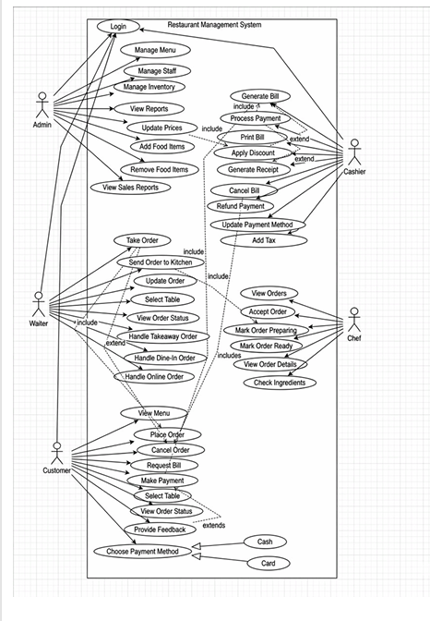
Use Case Diagram :

Slide 7
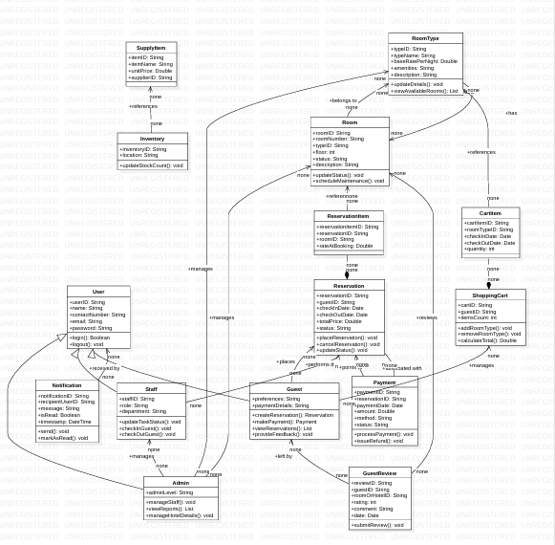
Analysis Class Diagram :

Slide 8
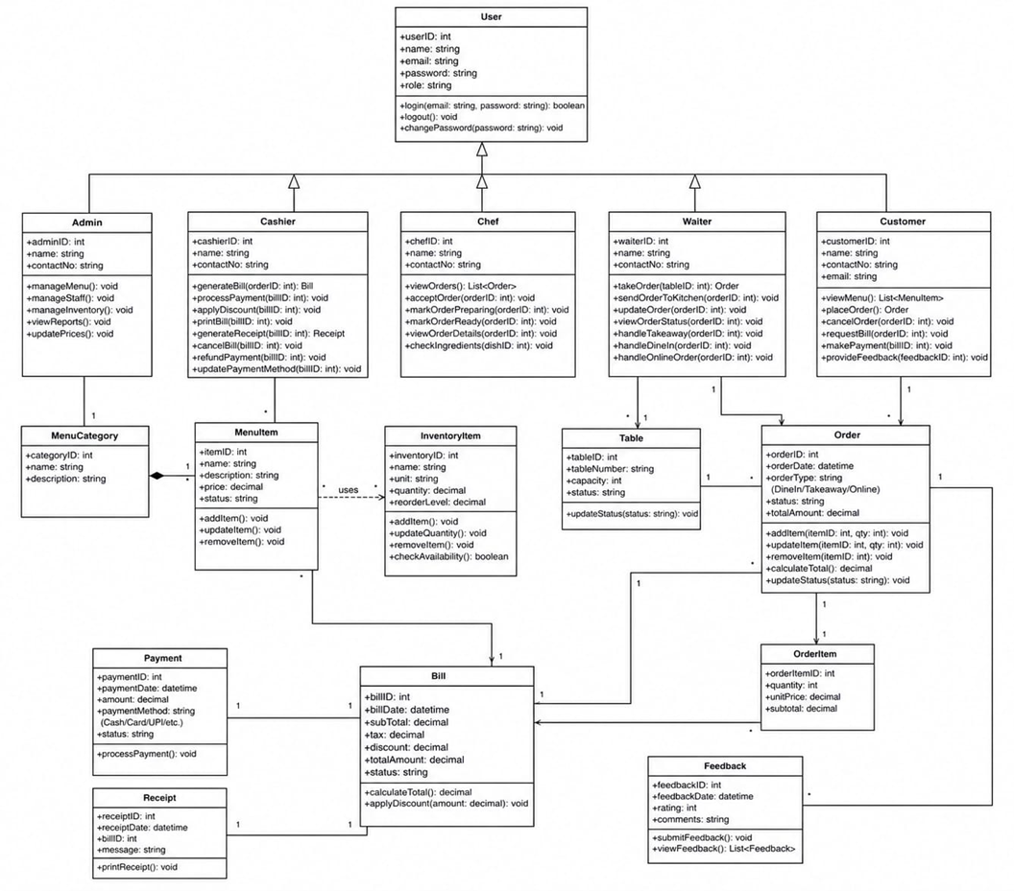
Design Class Diagram :

Slide 9
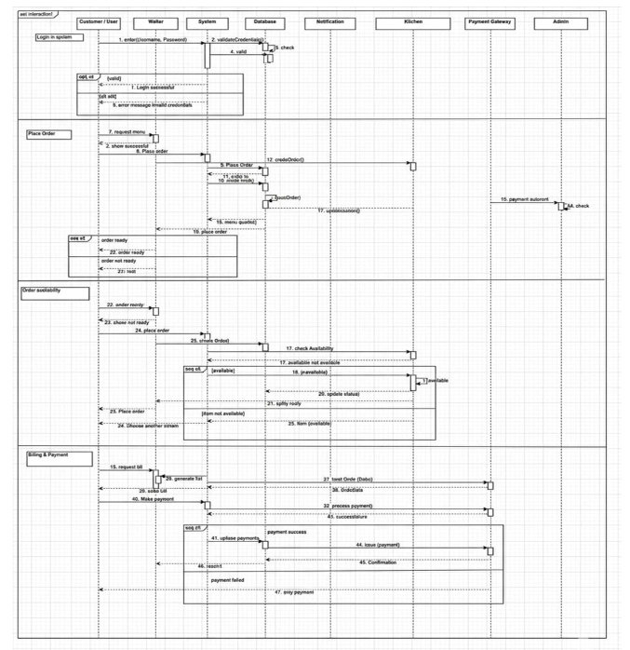
Sequence Diagram –

Slide 10
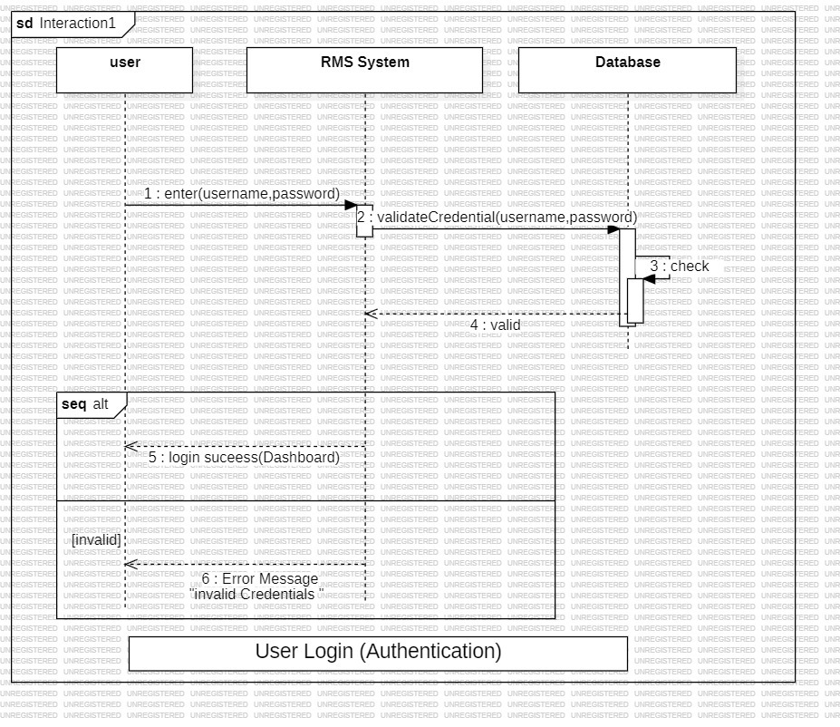
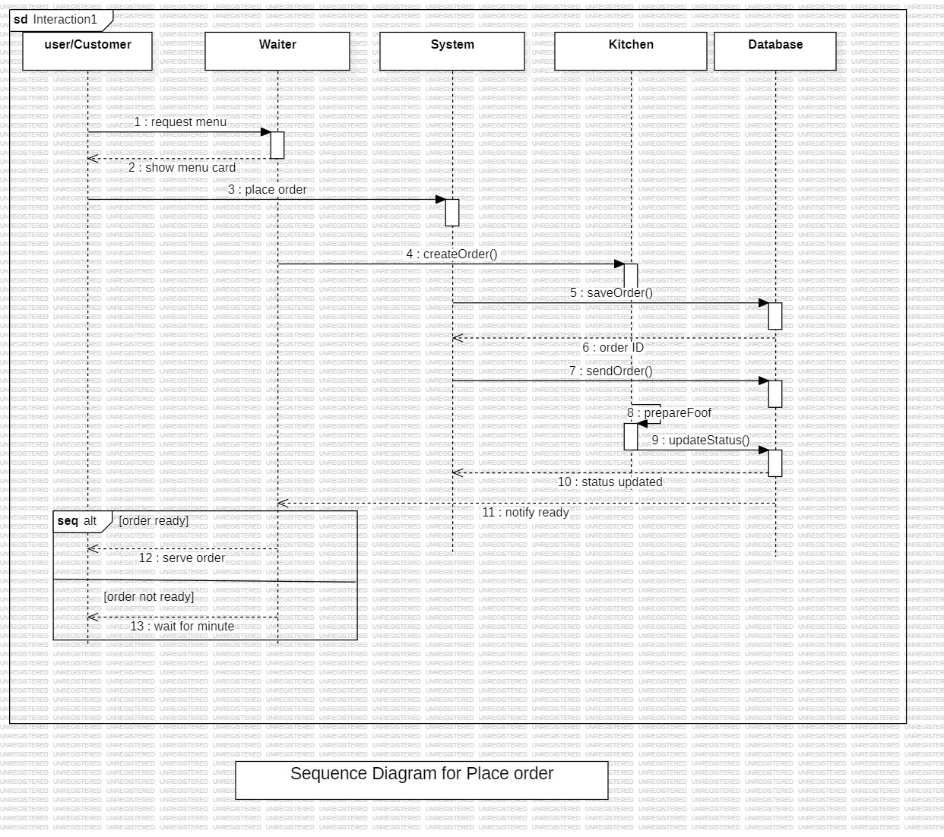
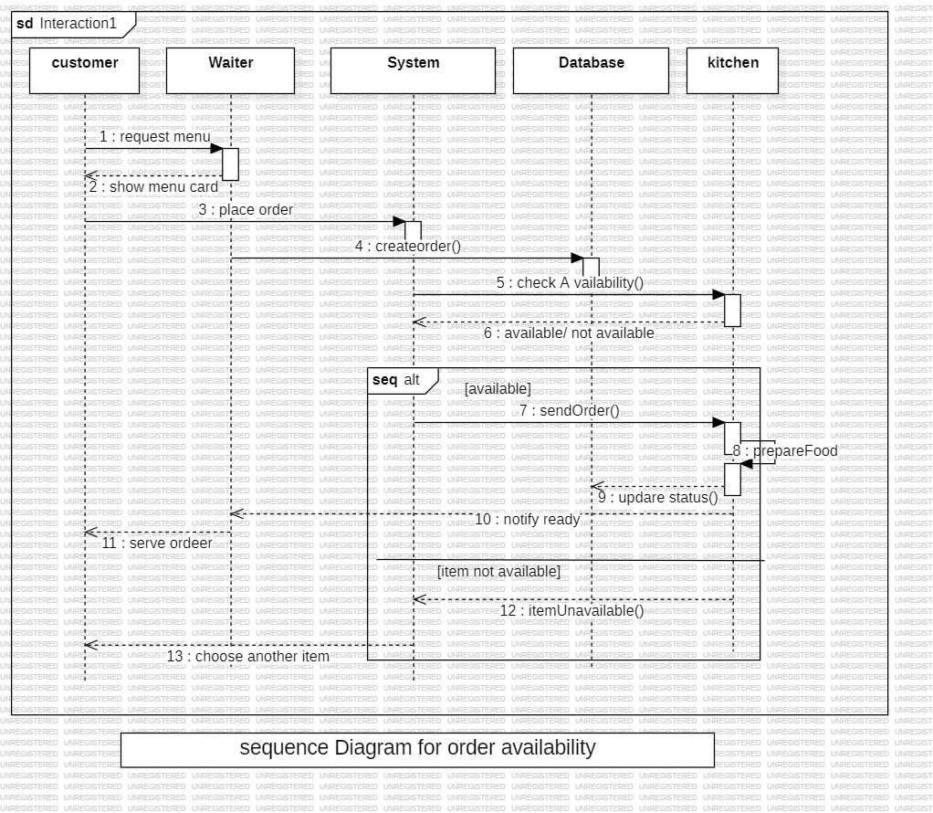
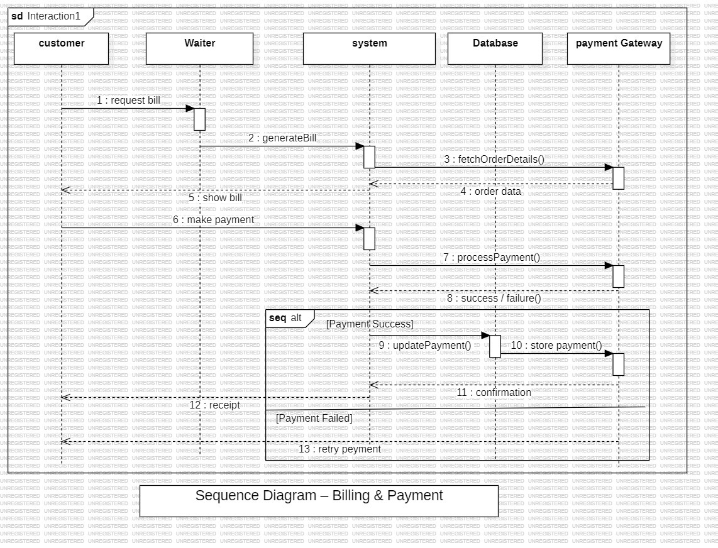
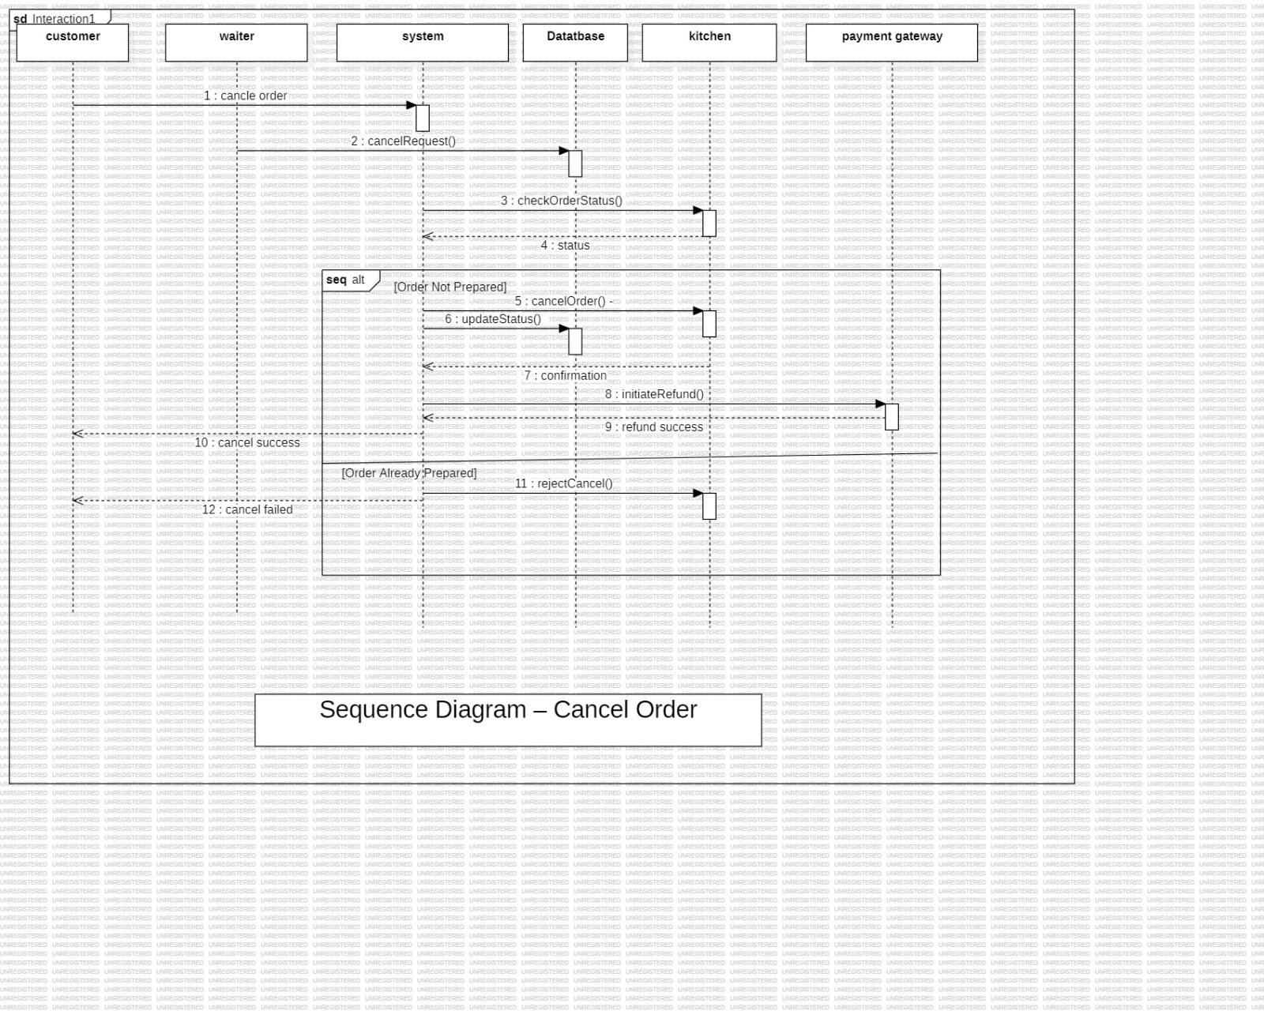
Sequence Diagram –

Slide 11
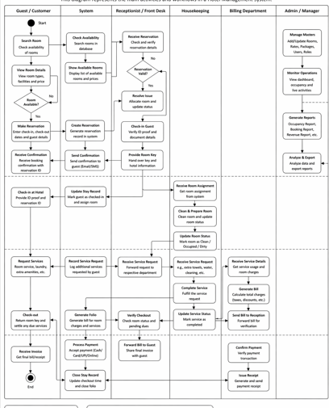
Activity Diagram :

Slide 12
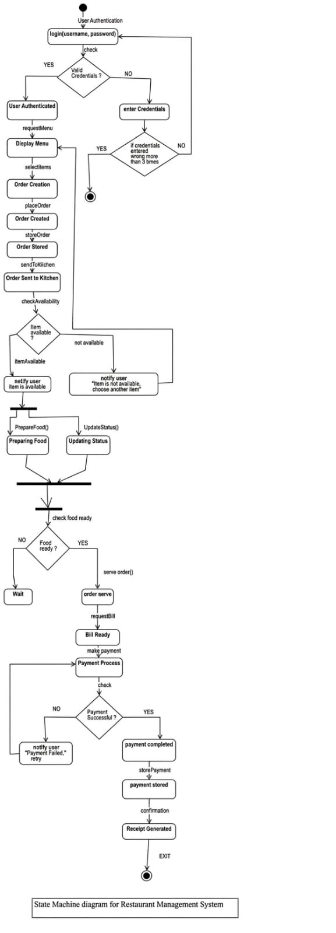
State Machine Diagram :

Slide 13
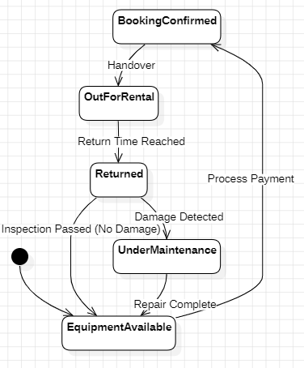
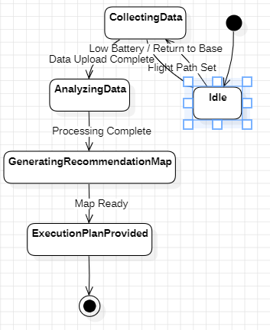
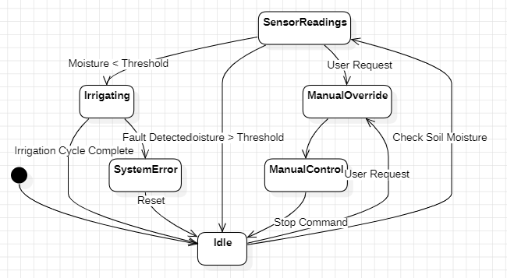
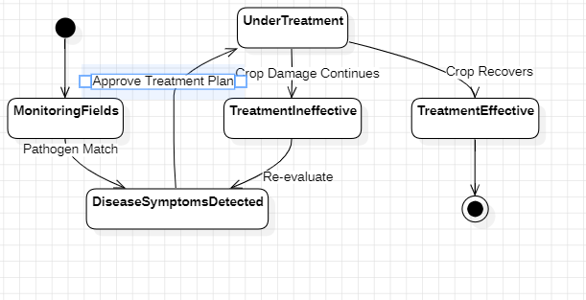
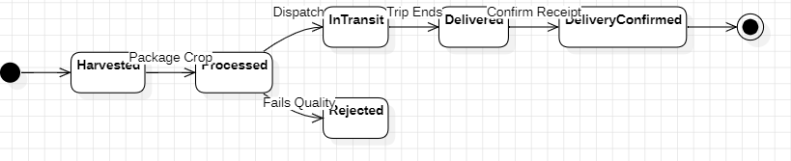
State Machine Diagram :

Slide 14
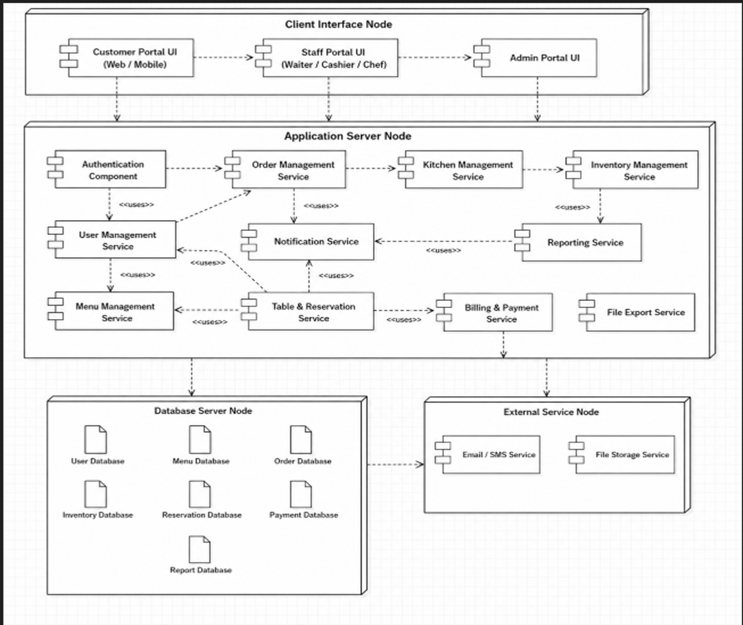
Component Diagram :

Slide 15
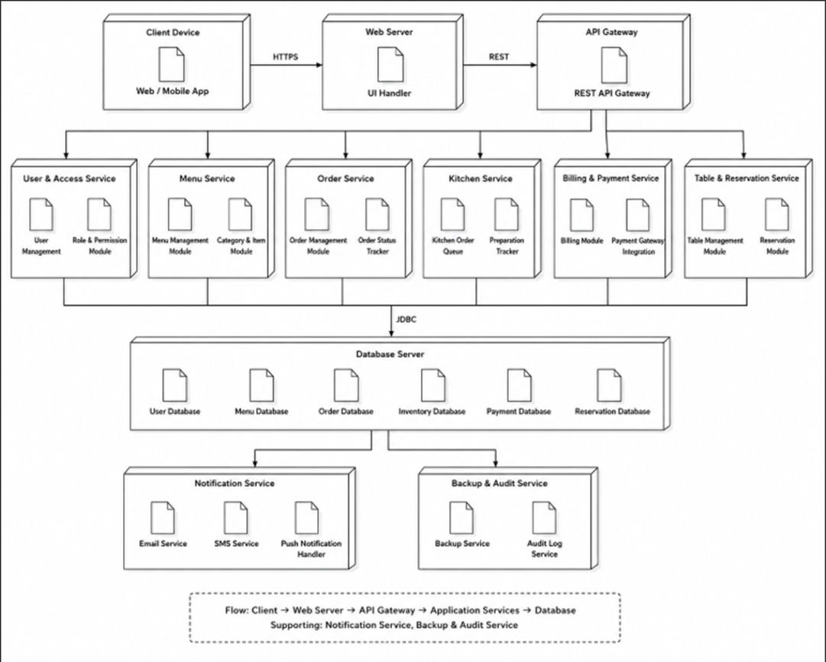
Deployment Diagram :

Slide 16
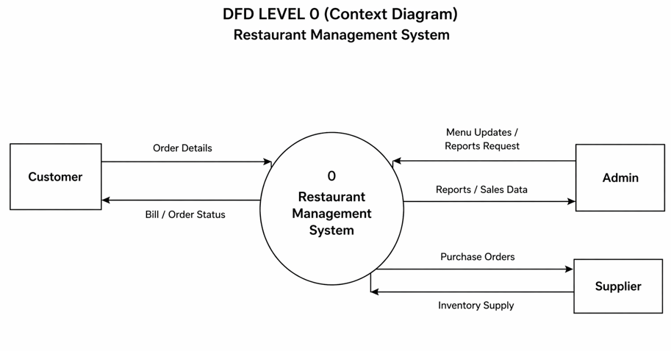
Data Flow Diagram (DFD):

Slide 17
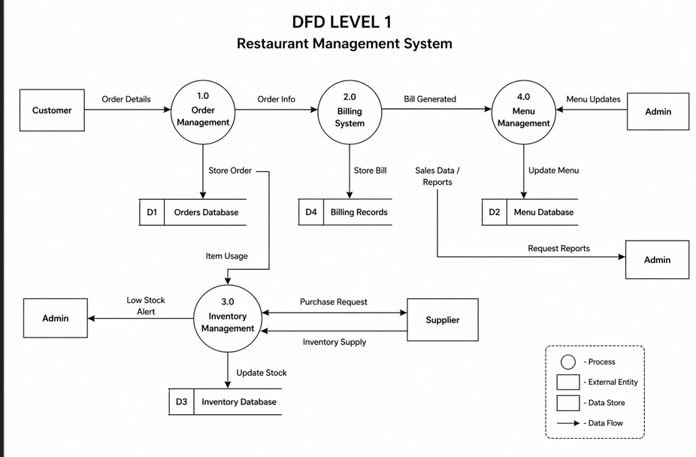
Data Flow Diagram (DFD):

Slide 18
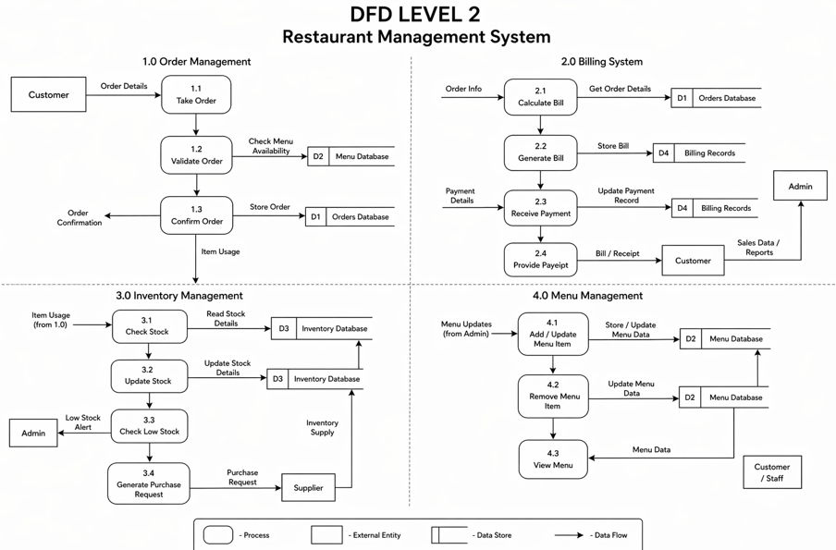
Data Flow Diagram (DFD):

Slide 19
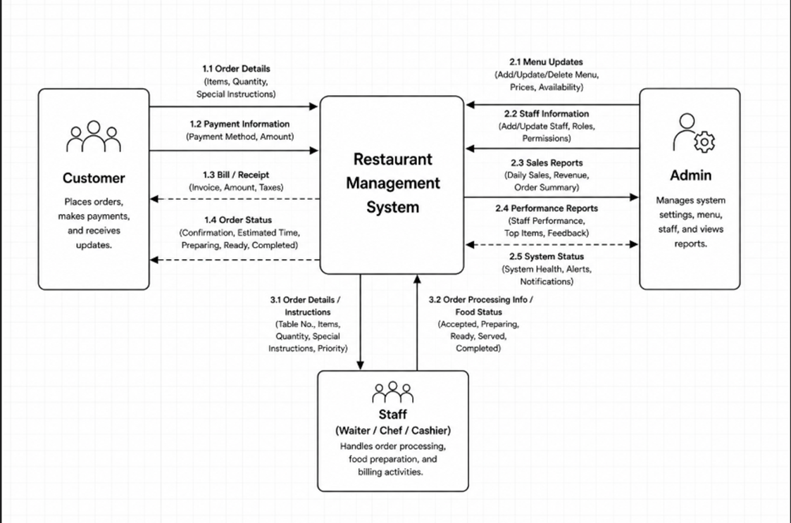
Control Flow Diagram (CFD):

Slide 20
Conclusion:
The Restaurant Management System provides an effective solution to the challenges faced in traditional restaurant operations. By digitizing daily activities, the system helps restaurant staff manage orders efficiently, monitor real-time table availability, and reduce dependency on manual record-keeping. The system improves operational transparency, minimizes administrative workload, and supports better decision-making for management. Features such as automated order processing, inventory management, billing integration, and customer relationship tracking make the system highly useful for restaurant managers and staff.

Slide 21
References:
1. Sommerville, I. Software Engineering, 10th Edition, Pearson Education.
2. Pressman, R. S. Software Engineering: A Practitioner’s Approach, McGraw-Hill.
3. Elmasri, R. and Navathe, S. B. Fundamentals of Database Systems, Pearson.
4. Object Management Group (OMG), Unified Modeling Language (UML) Specification.
5. IEEE, Software Requirements Specification (SRS) Standards.
6. Research papers and articles on Hotel Management System.

